Slide 1


SEER A Real-Time Pedestrian Detection and Tracking System for Intelligent Vehicles

Slide 2
Server
RSU
User Response Display
Web Application
REST JWT API
Detection model
Detection model
Video Stream
Admin Services
Continuous monitoring
Camera Monitoring

Slide 3
For notification and monitoring

Slide 4
UI Module: We used Angular framework to implement Webapp
Welcome/Landing Page
Registration Page
Login Page
Login Page
Login Page
Admin Page
User Response Page

Slide 5
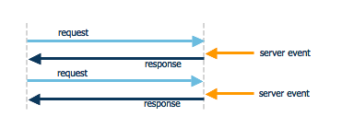
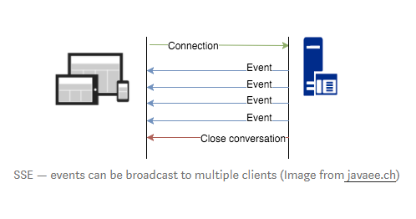
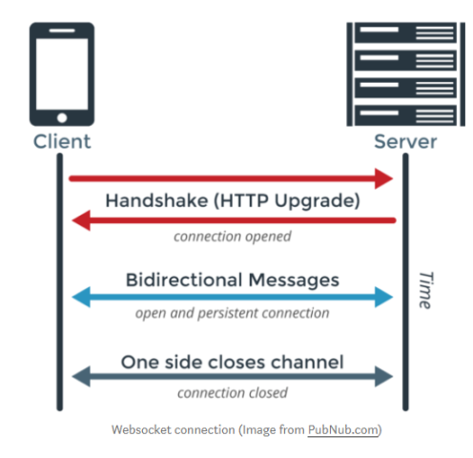
Communication Methods used for Data/video streaming
HTTP Polling: There’s a predefined time gap between two request
SSE (Server Sent Events/EventSource): SSE connections can only push data to the browser. (communication is carried out from server to browser only, browsers can only subscribe to data updates originated by the server, but cannot send any data to the server)
WEB Socket: WebSockets allow both the server and the client to push messages at any time without any relation to a previous request. Bi-directional protocol — either client/server can send a message to the other party Full-duplex communication — client and server can talk to each other independently at the same time.

Slide 6
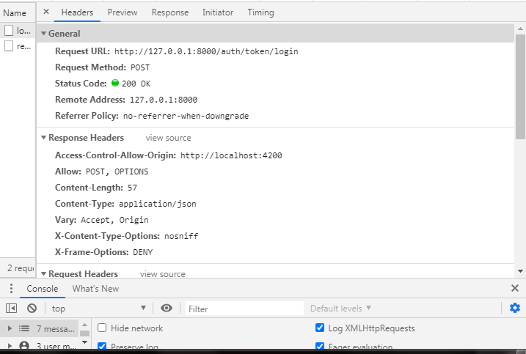
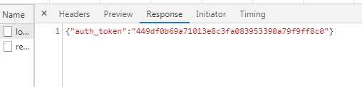
Authentication is based on Backend APIs uses Django REST JWT
Request
Response

Slide 7


Network OAM (Operations, administration and management)
For Node Monitoring, we tested Open Source (NMS) Network Management System
Open wisp
Nagios

Slide 8
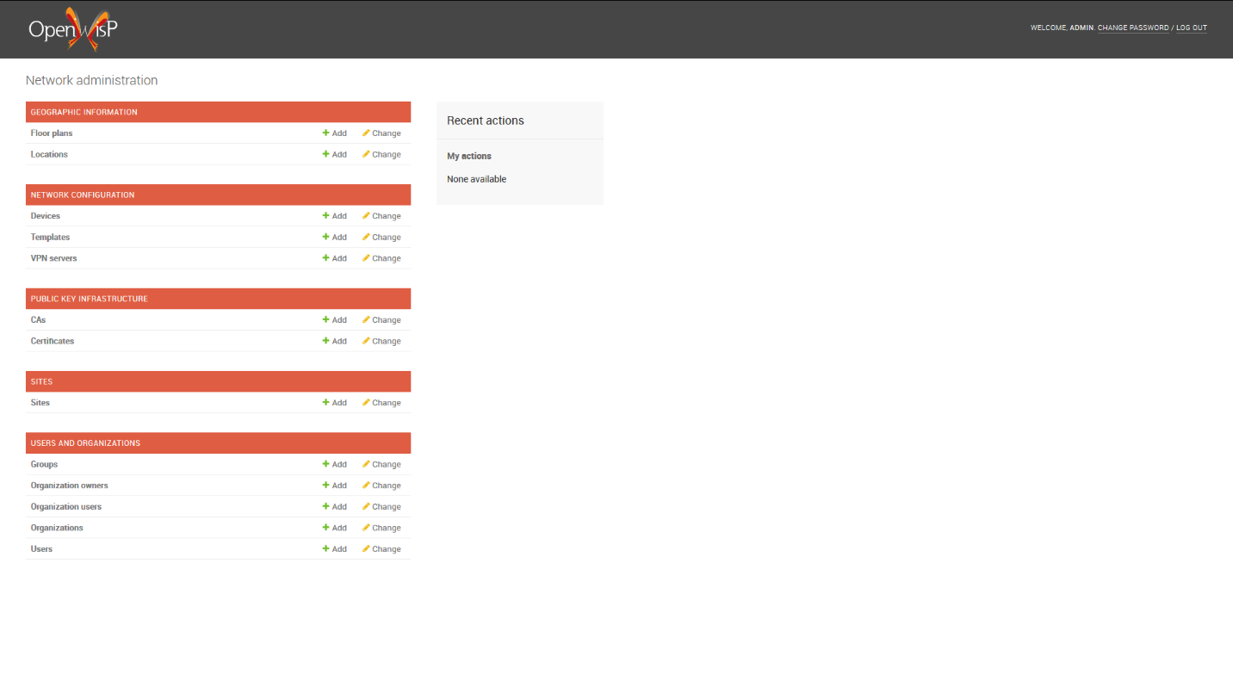
Tested both OpenWisp and Nagios

Slide 9
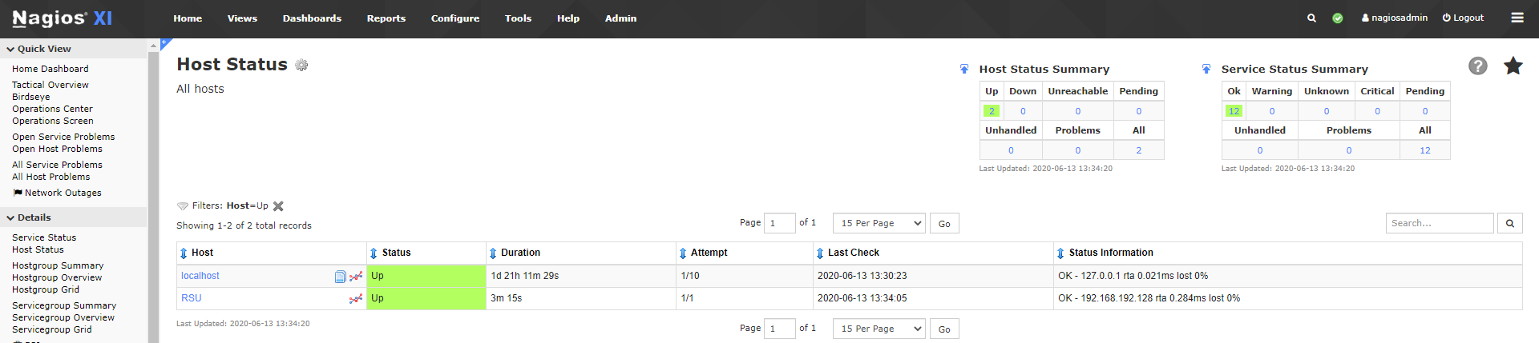
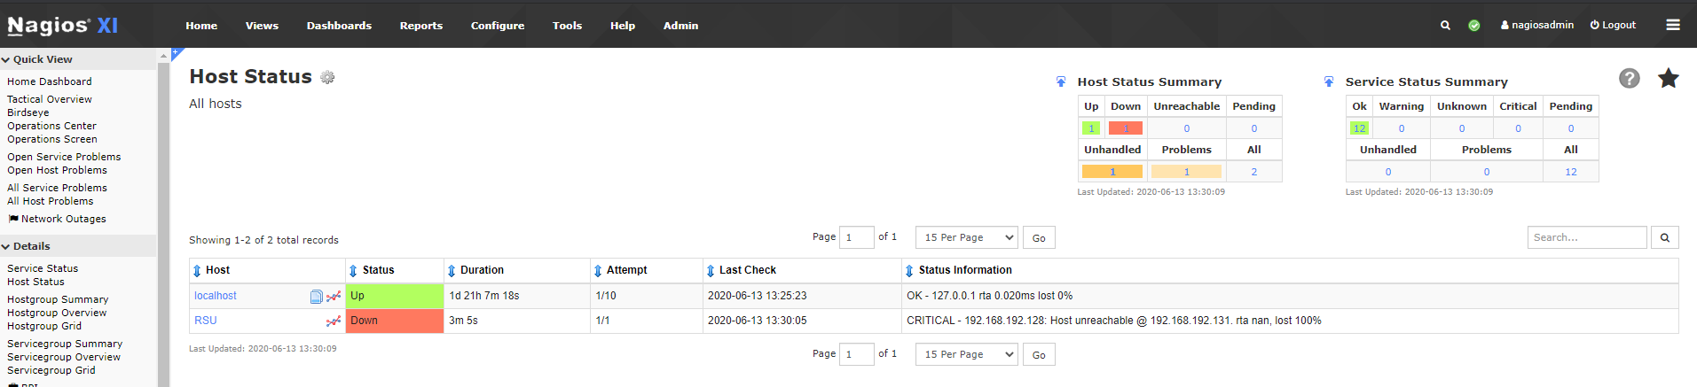
Finally integrated with Nagios as it provided more features

Slide 10
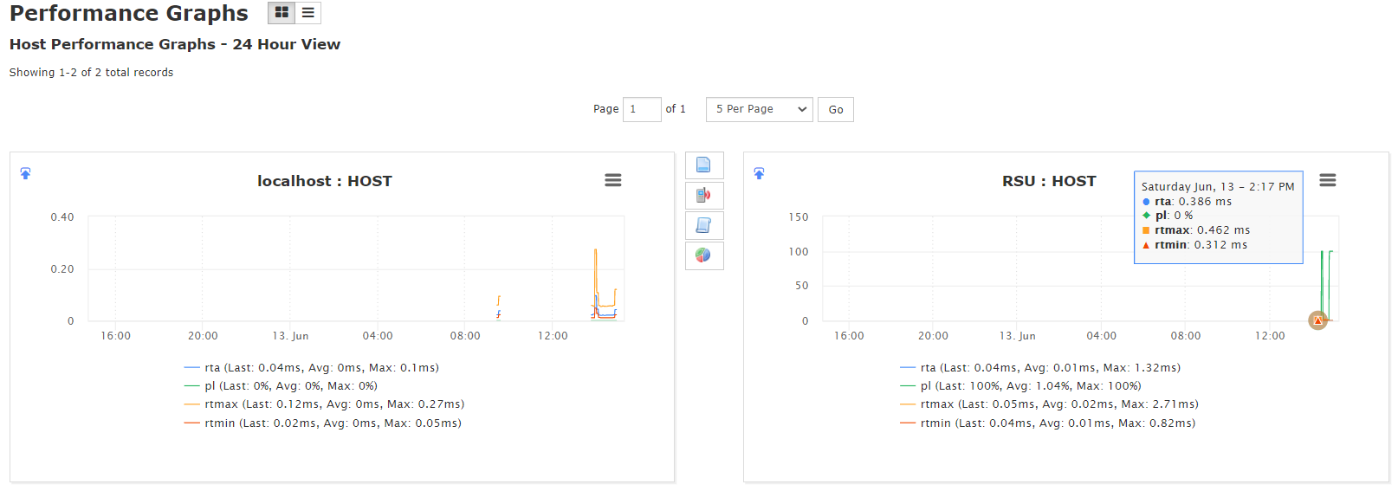
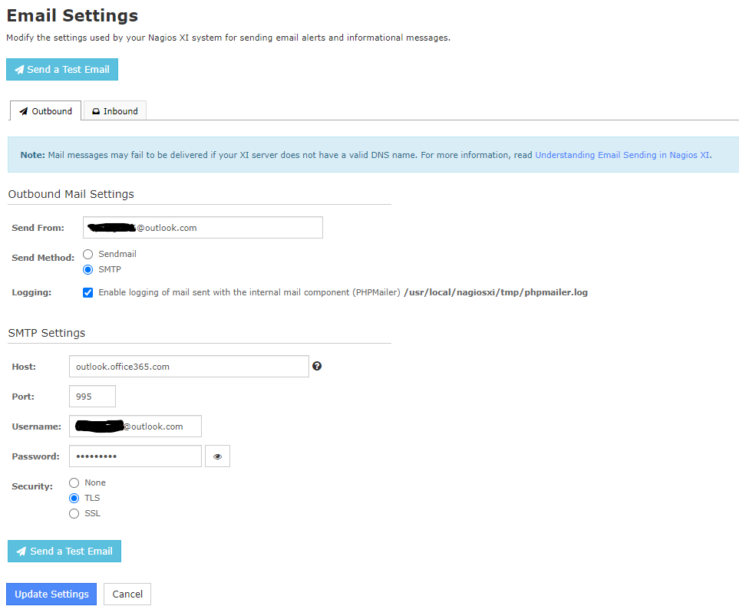
Sample of features for notification and monitoring

Slide 11
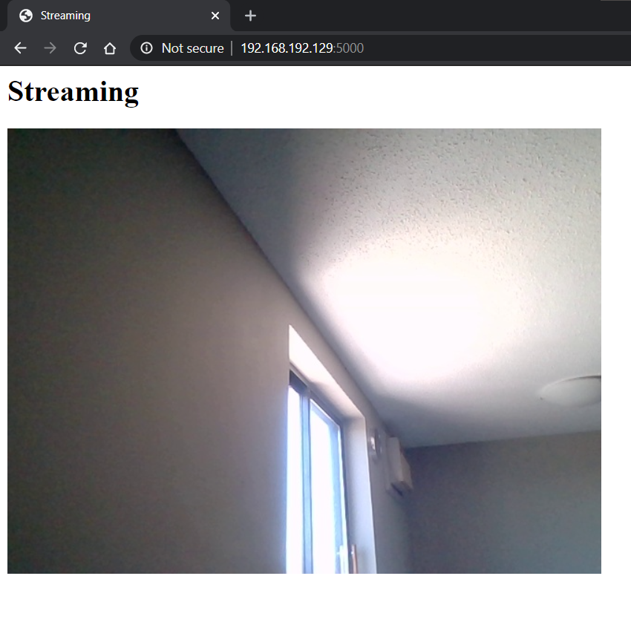
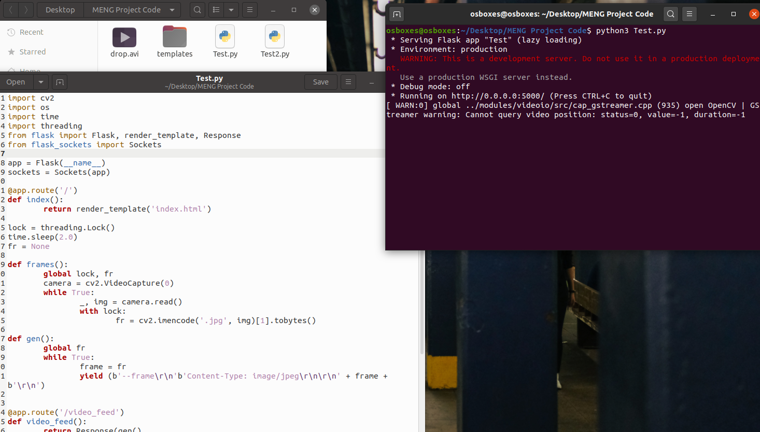

Camera feed generated via (flask WebSockets) to connect to detection model and server at a same time.

Slide 12



Camera Monitoring
For Camera Monitoring, we tested 3 different Open Source systems
Zoneminder
iSPY
Motioneye

Slide 13
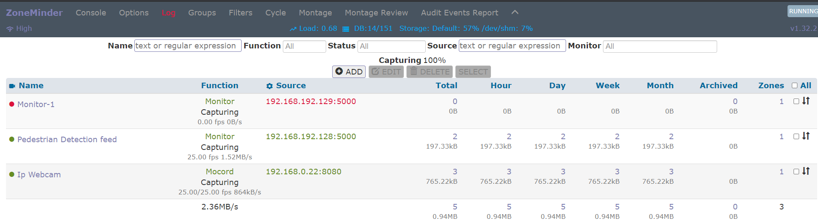
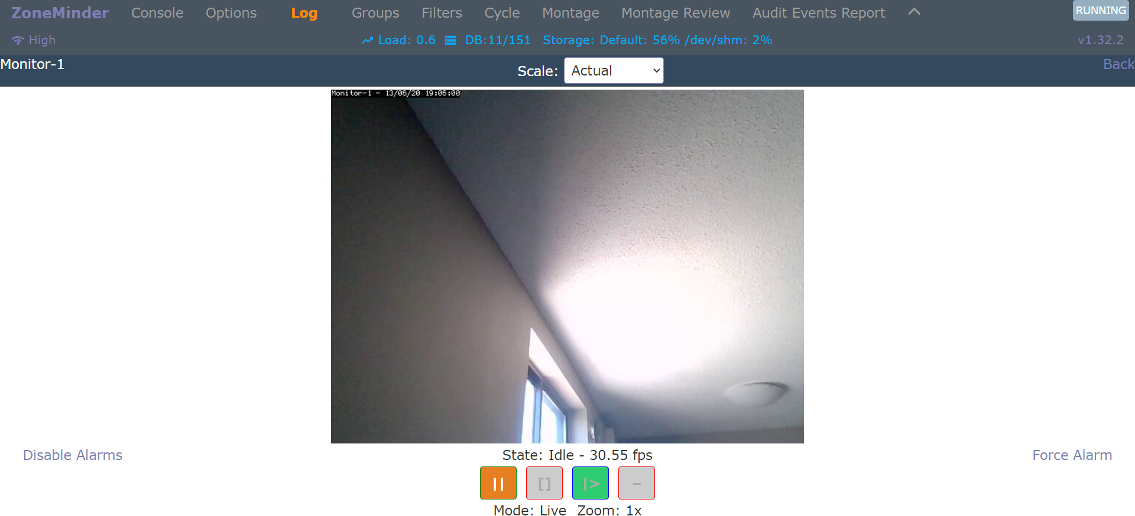
Finally integrated Zoneminder and successfully connected Camera feed to both detection model and Zone minder

Slide 14
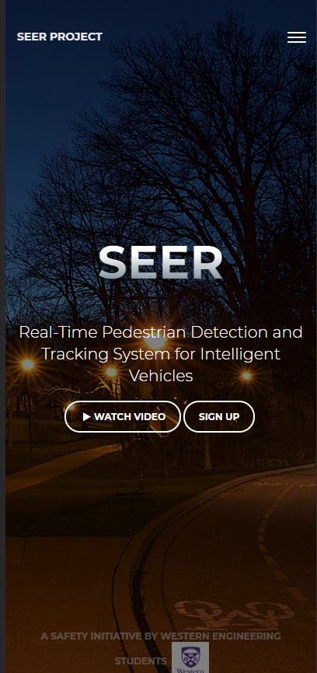
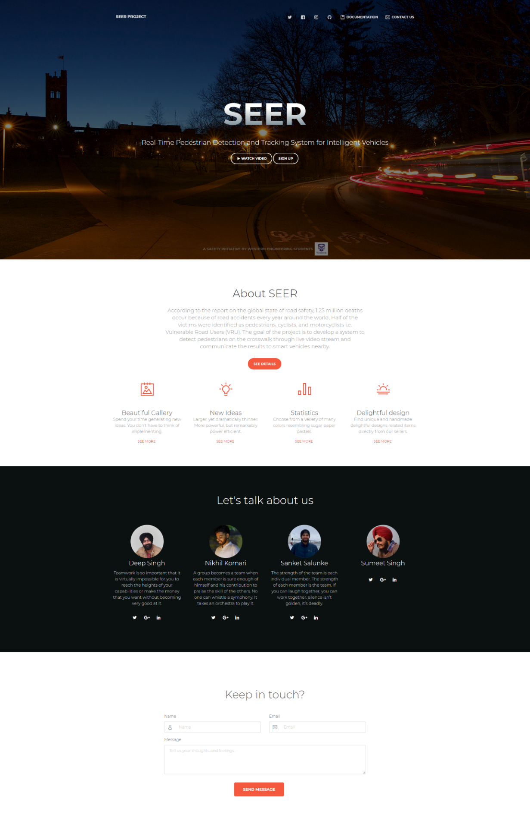
UI Module: Template 1. Welcome Page

Slide 15
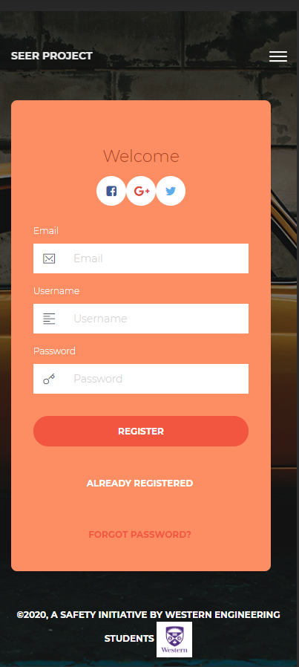
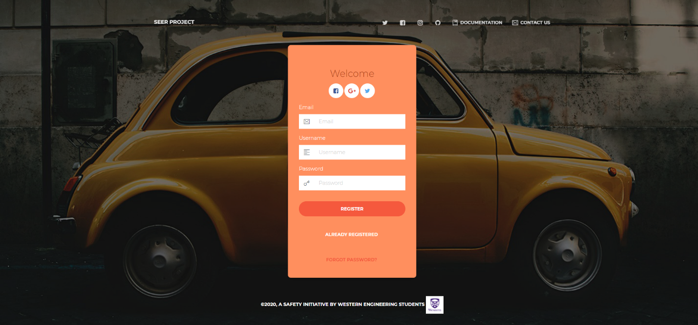
UI Module: Screens 2. Registration Page

Slide 16
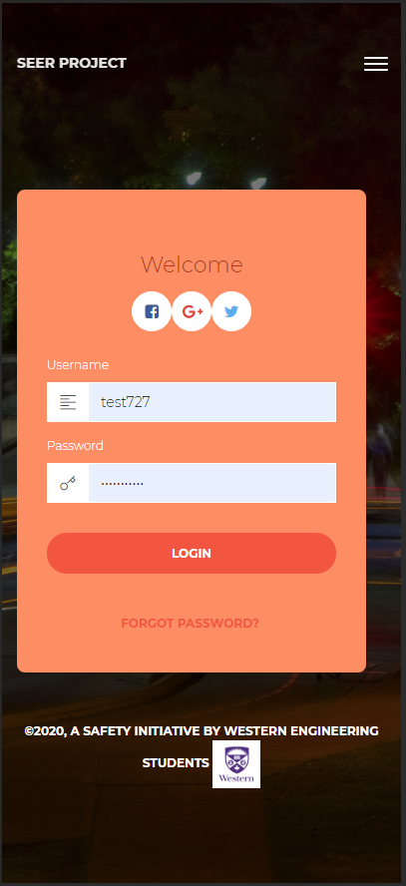
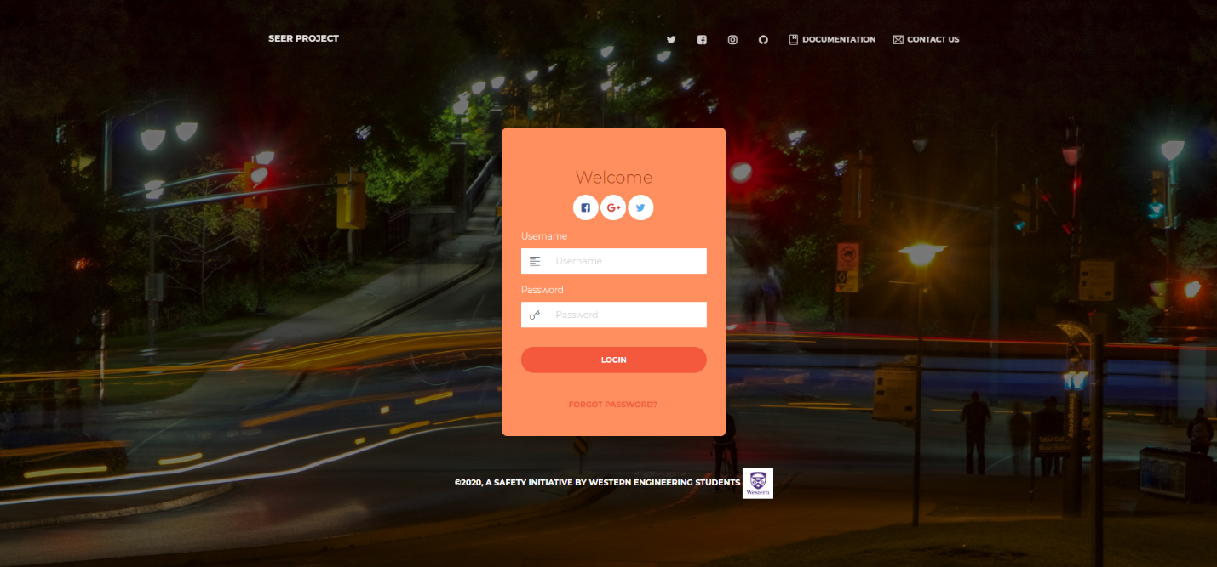
UI Module: Screens 3. Login Page

Slide 17
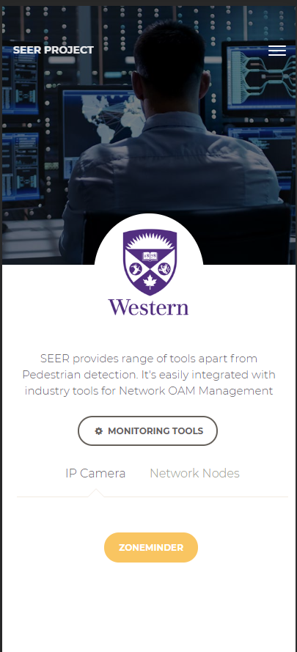
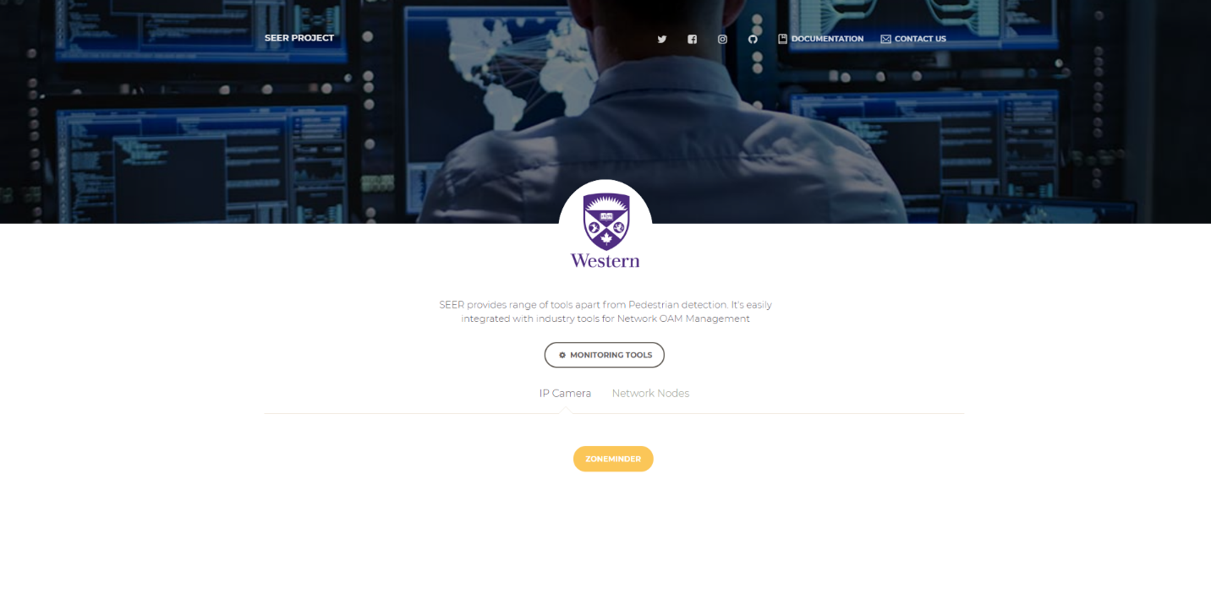
UI Module: Screens 4. Admin Page

Slide 18
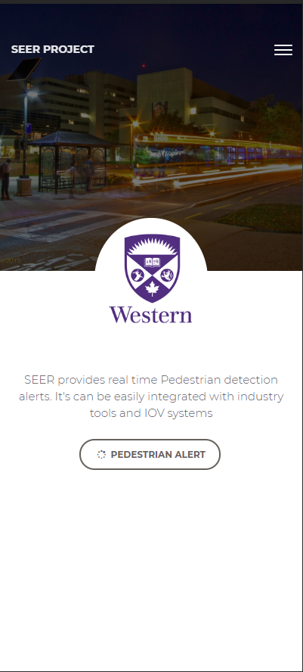
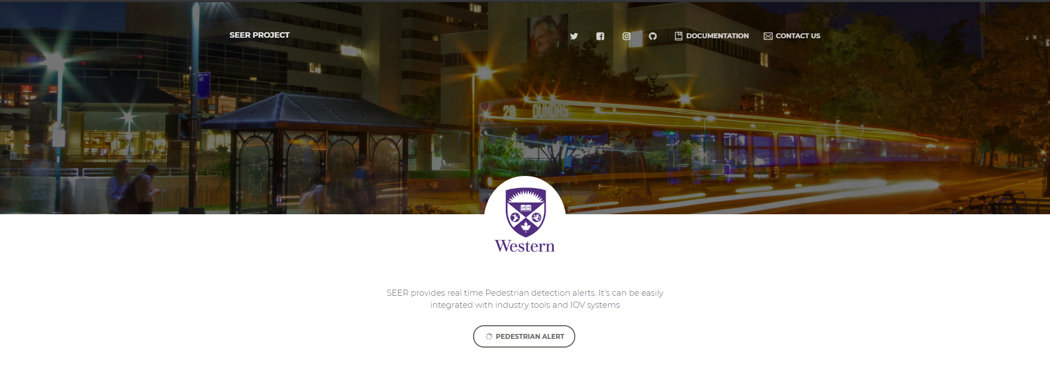
UI Module: Screens 4. Response Page

Slide 19
Thank You

